Slide 1
Developing with .NET 5 and App-Owns-Data Embedding
Ted Pattison
Principal Program Manager
Customer Advisory Team (CAT) at Microsoft

Slide 2
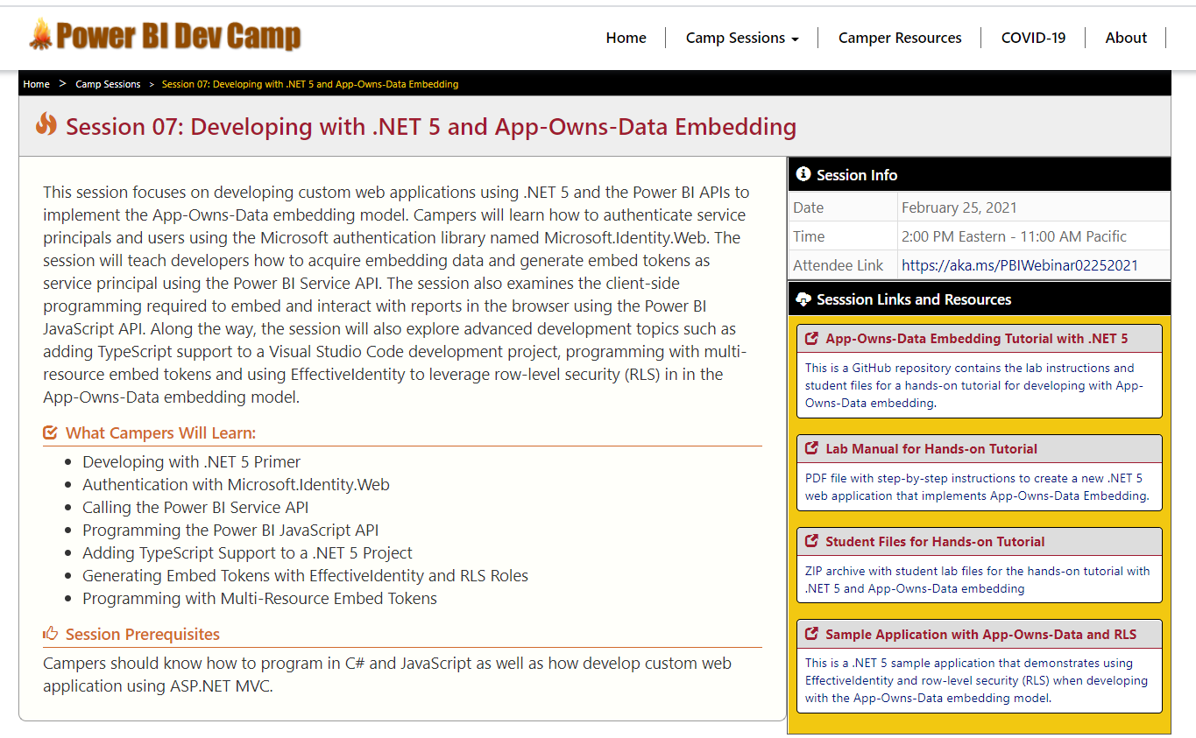
Welcome to Power BI Dev Camp
Power BI Dev Camp Portal - https://powerbidevcamp.net

Slide 3
Agenda
Developing for Power BI with .NET 5
Introducing Microsoft.Identity.Web
Calling to Power BI as Service Principal
Programming the Power BI JavaScript API
Adding TypeScript Support to a .NET 5 Project
Programming with Multi-Resource Embed Tokens
Integrating RLS using EffectiveIdentity

Slide 4
Power BI Embedding – The Big Picture
User launches your app using a browser
App authenticates with Azure Active Directory and obtains access token
App uses access token to call to Power BI Service API
App retrieves data for embedded resource and passes it to browser.
Client-side code uses Power BI JavaScript API to create embedded resource
Embedded resource session created between browser and Power BI service
5
Power BI Service
Browser
iFrame
6
4
4
3
1
Your App
2
Azure AD

Slide 5
Choosing the Correct Embedding Model
User-Owns-Data Embedding
All users require a Power BI license
Useful in corporate environments
App authenticates as current user
Your code runs with user’s permissions
User’s access token passed to browser
App-Owns-Data Embedding
No users require Power BI license
Useful in commercial applications
App authenticates with app-only identity
Your code runs with admin permissions
Embed token passed to browser
User-Owns-Data Embedding for use within Organization
App-Owns-Data Embedding for use by ISVs
Browser
Power BI Service
Browser
Power BI Service
iFrame
iFrame
Azure AD
Access Token
Power BI
Embed Token

Slide 6
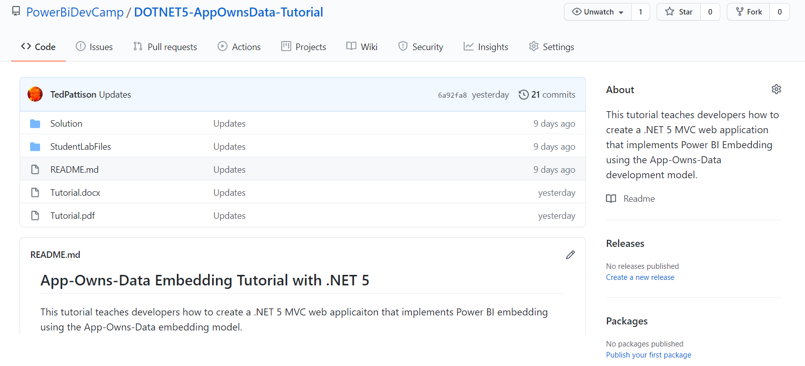
App-Owns-Data .NET 5 Tutorial
Stored in a GitHub repository for easy download
https://github.com/PowerBiDevCamp/DOTNET5-AppOwnsData-Tutorial

Slide 7
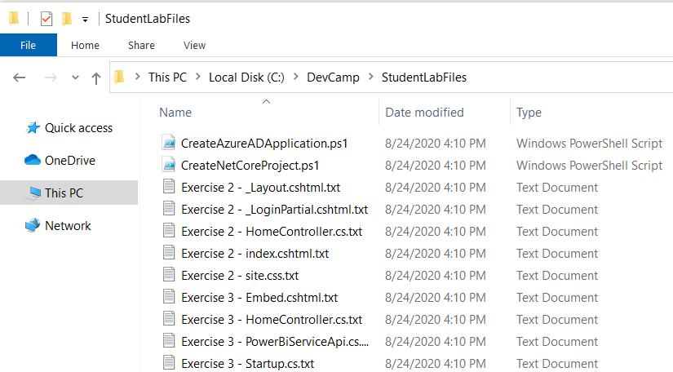
Copying-and-Pasting Code

Slide 8
Tutorial Exercise Flow
Exercise 1: Create a New Azure AD Application
Exercise 2: Create a .NET 5 Project for a Secure Web Application
Exercise 3: Call the Power BI Service API
Exercise 4: Embedding a Report using powerbi.js
Exercise 5: Adding TypeScript Support to a .NET 5 Project
Exercise 6: Creating a View Model for App Workspaces

Slide 9
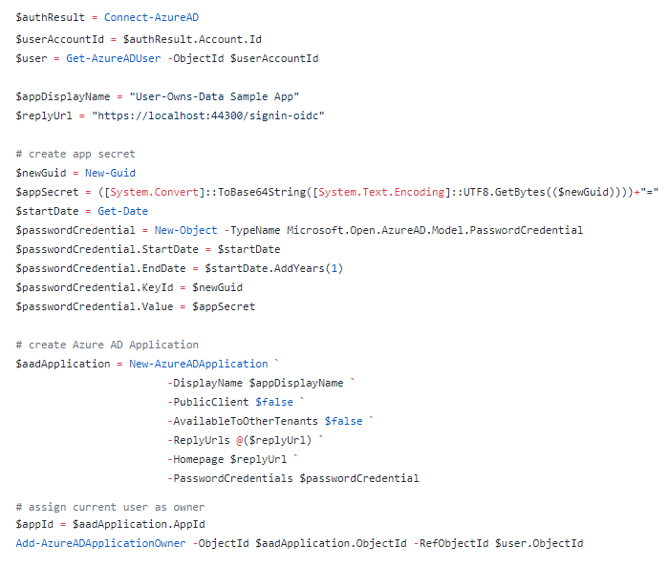
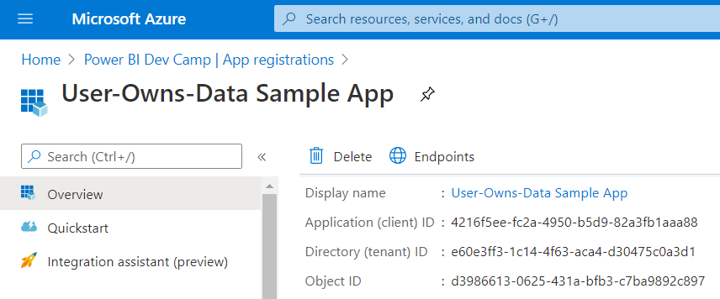
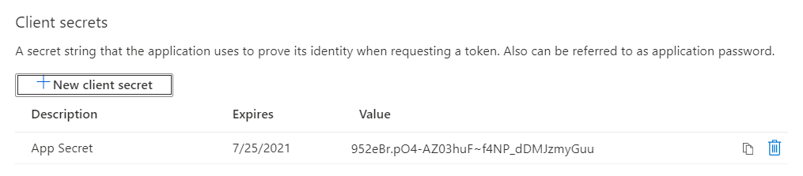
Creating Azure AD Application with PowerShell

Slide 10
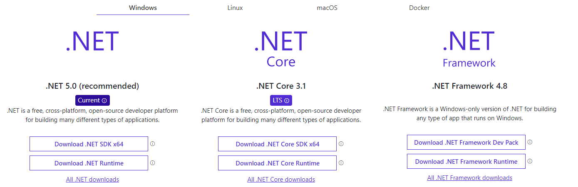
Install .NET 5 SDK
https://dotnet.microsoft.com/download

Slide 11
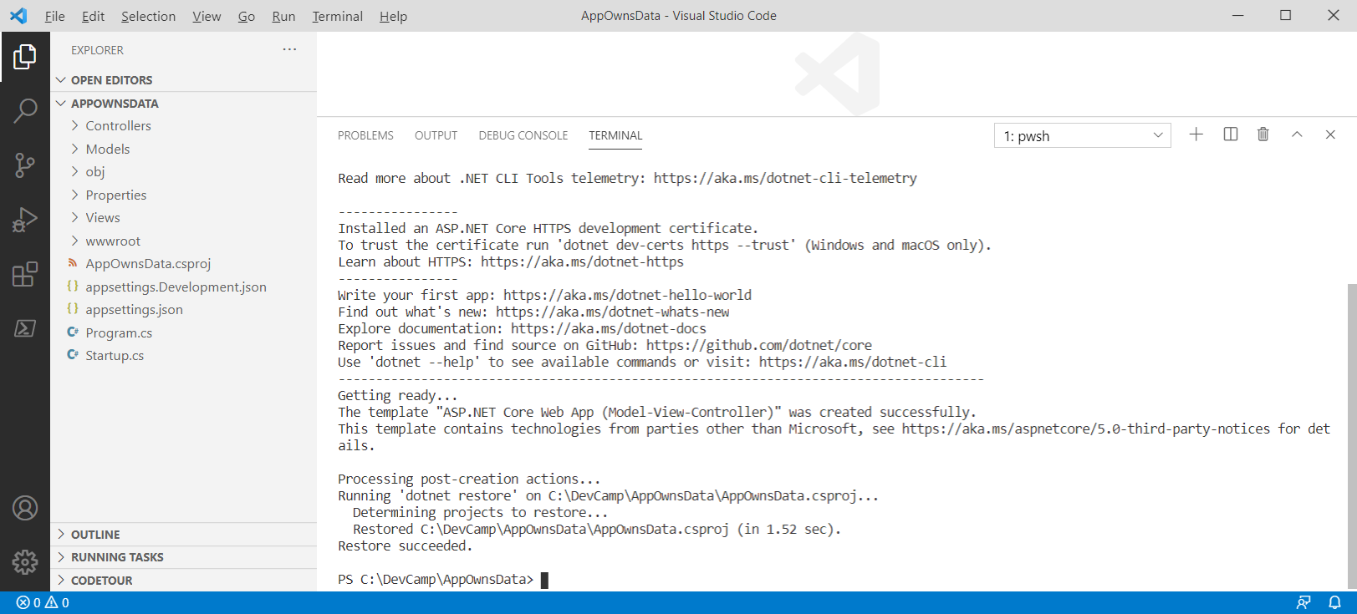
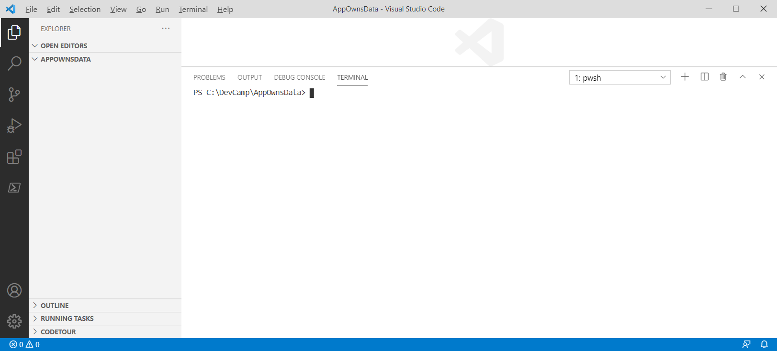
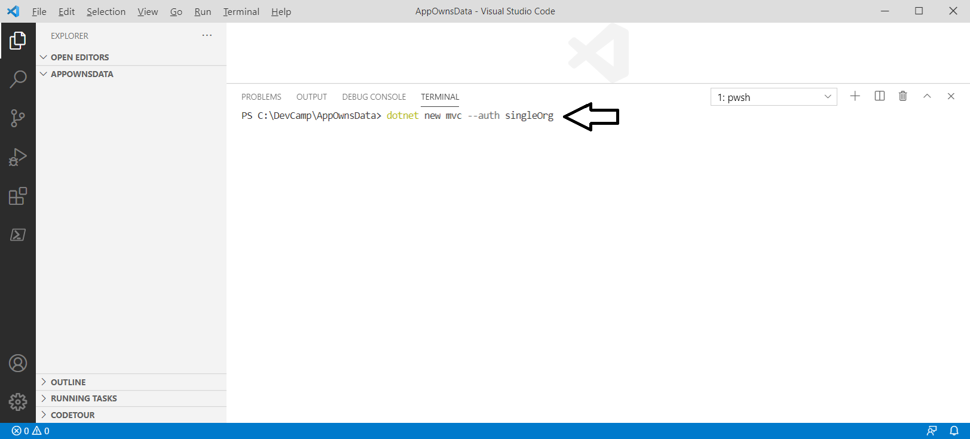
Getting Started with the .NET 5 CLI
Command to create a new project> dotnet new mvc –auth singleOrg

Slide 12
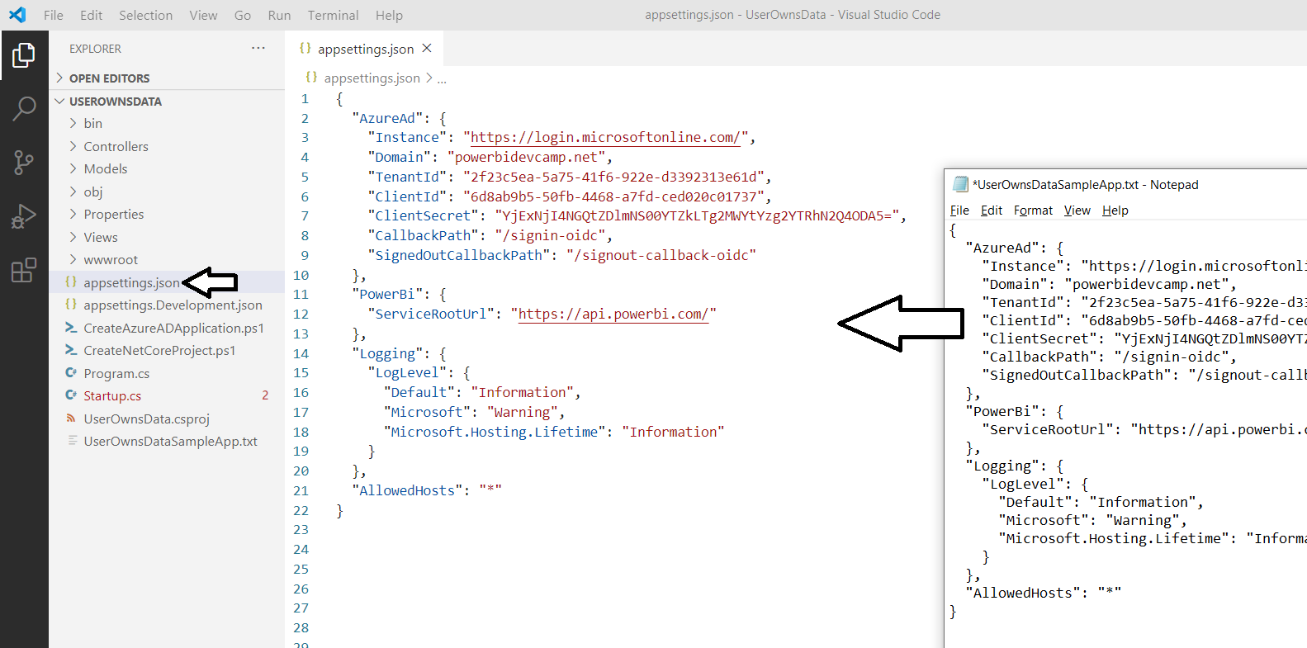
Azure AD Configuration in appsettings.json

Slide 13
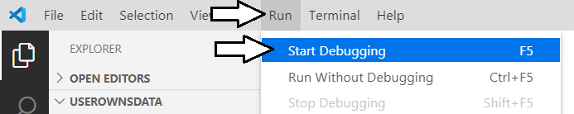
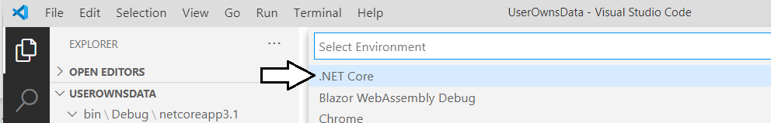
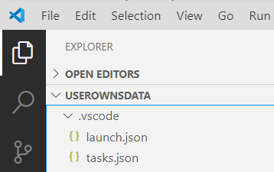
Starting a .NET 5 Debugging Session

Slide 14
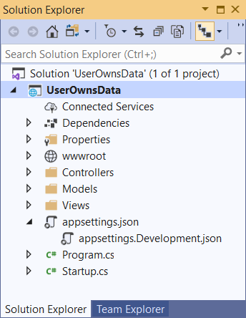
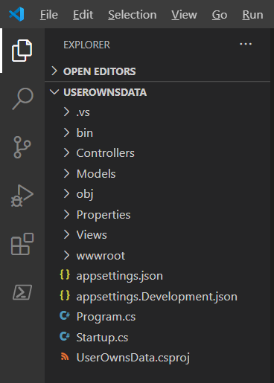
Visual Studio 2019 versus Visual Studio Code
Should you use Visual Studio 2019 versus Visual Studio Code?
Yes, either one can be used to develop for .NET 5 3.1 and .NET 5

Slide 15
Agenda
Developing for Power BI with .NET 5
Introducing Microsoft.Identity.Web
Calling to Power BI as Service Principal
Programming the Power BI JavaScript API
Adding TypeScript Support to a .NET 5 Project
Programming with Multi-Resource Embed Tokens
Integrating RLS using EffectiveIdentity

Slide 16
Introducing Microsoft.Identity.Web
What is Microsoft.Identity.Web
Strategic authentication library for Azure AD to assist developers
Used to perform authentication in Web applications and Web APIs
Used to acquire access tokens
Used to implement token caching
Scenarios where you should use Microsoft.Identity.Web
When developing Web applications and APIs built on .NET 3.1 and .NET 5
When authenticating users and acquiring user tokens
When authenticating service principals and acquiring app-only tokens
More info at https://github.com/AzureAD/microsoft-identity-web/wiki

Slide 17
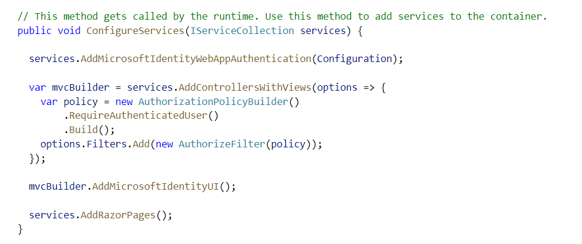
Enabling Authentication with Microsoft.Identity.Web

Slide 18
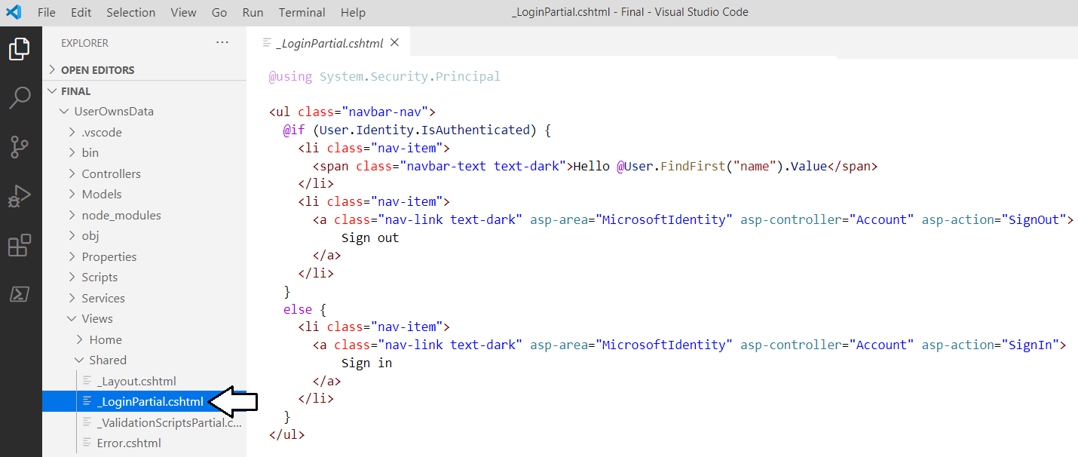
Adding Sign in / Sign Out Links

Slide 19
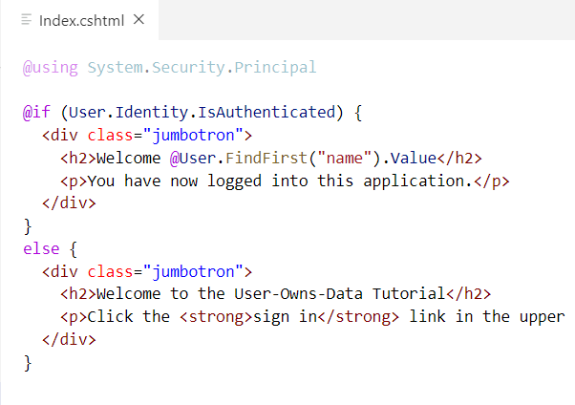
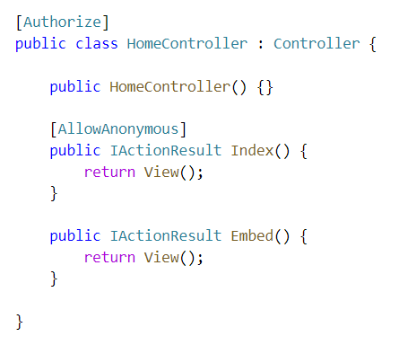
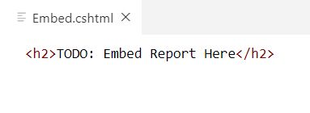
ASP.NET Supports Route Authorization
Routes with [AllowAnonymous] accessible to anonymous user
Routes secured with [Authorize] only accessible to authenticated users
Navigating to secured route automatically prompts for sign in
Index.cshtml
Embed.cshtml

Slide 20
Agenda
Developing for Power BI with .NET 5
Introducing Microsoft.Identity.Web
Calling to Power BI as Service Principal
Programming the Power BI JavaScript API
Adding TypeScript Support to a .NET 5 Project
Programming with Multi-Resource Embed Tokens
Integrating RLS using EffectiveIdentity

Slide 21
What Is the Power BI Service API?
What is the Power BI Service API?
API built on OAuth2, OpenID Connect, REST and ODATA
API secured by Azure Active Directory (AAD)
API to program with workspaces, datasets, reports & dashboards
API also often called “Power BI REST API”
What can you do with the Power BI Service API?
Publish PBIX project files
Update connection details and datasource credentials
Create workspaces and clone content across workspaces
Embed Power BI reports and dashboards tiles in web pages
Create streaming datasets in order to build real-time dashboards

Slide 22
App-only Access Control
Service Principal used to configure access control
Requires the use of v2 app workspaces
Service principal added to app workspaces as admin
Access control NOT based on Azure AD permissions
App Workspace 1
Admins
User 1
User 2
App 1 Service Principal
Power BI Service
App 1 Service Principal
App-only Access Token
App Workspace 2
Admins
User 1
App 1 Service Principal
App 2 Service Principal

Slide 23
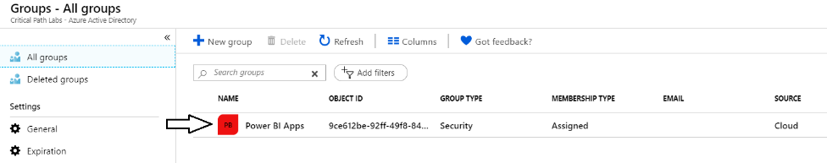
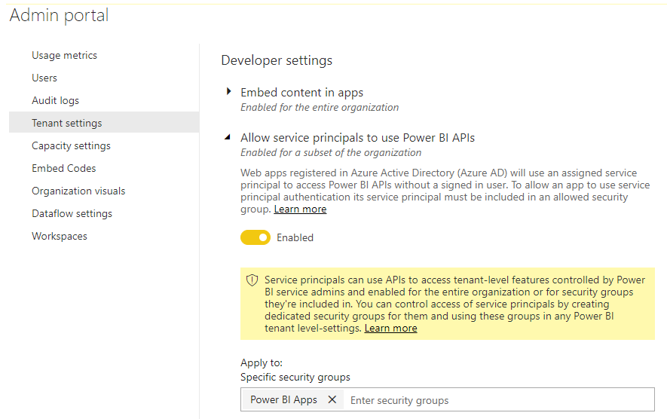
Setting Up for App-Owns-Data – Part 1
Enable Service Principal Access to Power BI Service API
Create an Azure AD security group (e.g. Power BI Apps)
Add group to Power BI Allow service principals to use Power BI APIs

Slide 24
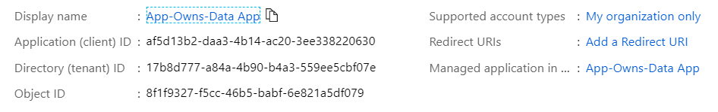
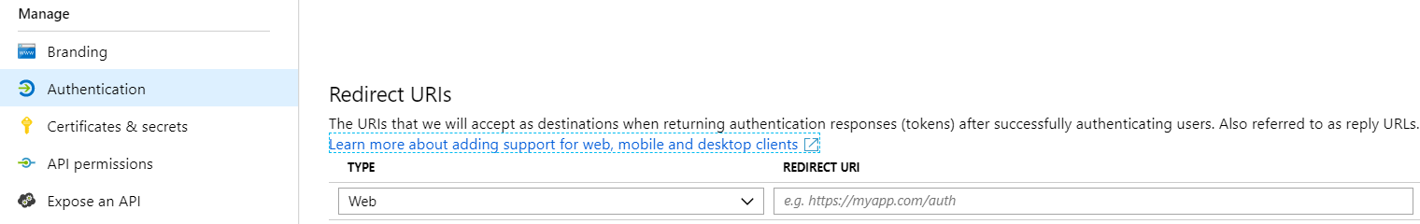
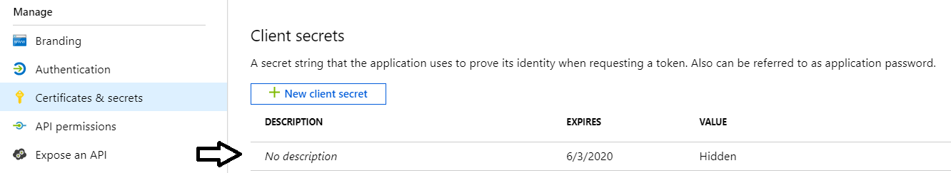
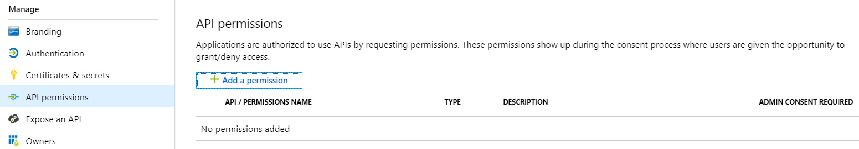
Setting Up for App-Owns-Data – Part 2
Create a confidential client in your Azure AD tenant
Configured as TYPE=Web and no need for a redirect URL
Add a client secret or a client certificate No need to configure any permissions

Slide 25
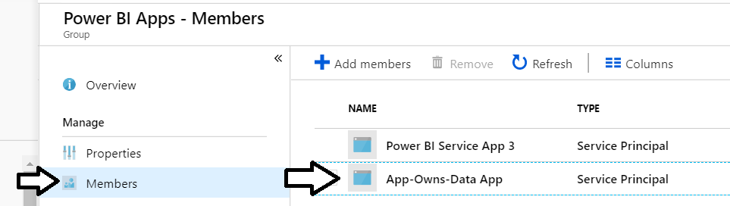
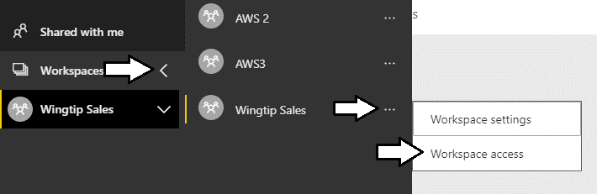
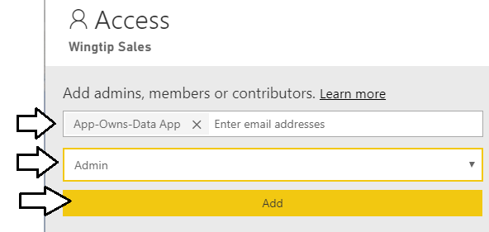
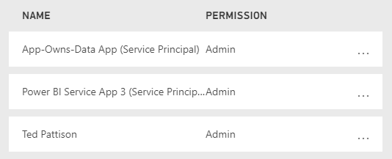
Setting Up for App-Owns-Data – Part 3
Add application's service principal in Power BI Apps security group
Configure application's service principal as workspace admin
Service principal should now be workspace admin

Slide 26
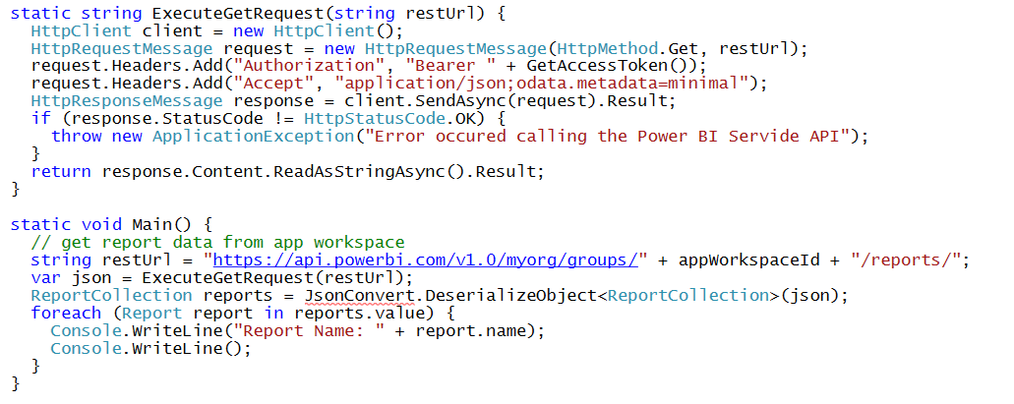
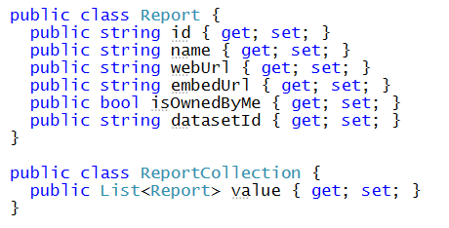
Calling Directly to the Power BI Service API This is a sample of C# code that does not use the Power BI .NET SDK
Your C# Code
Power BI
Service API
Executing HTTP Requests
Capturing HTTP Responses
Serializing/Deserializing JSON

Slide 27
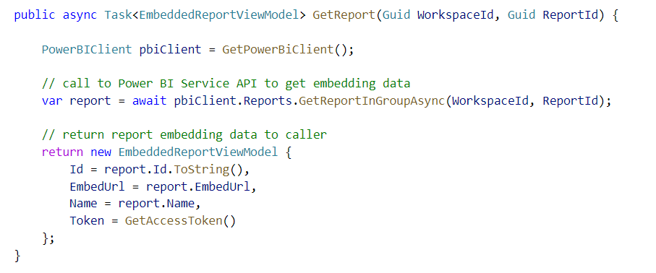
Power BI .NET SDK
Developing without the Power BI .NET SDK
Developing with the Power BI .NET SDK
Your C# Code
Power BI
Service API
Executing HTTP Requests
Capturing HTTP Responses
Serializing/Deserializing JSON
Your C# Code
Power BI
Service API
Power BI .NET SDK
Executing HTTP Requests
Capturing HTTP Responses
Serializing/Deserializing JSON

Slide 28
Exercise 3 Call the Power BI Service API
Add a new class named PowerBiServiceApi
Add support to acquire access tokens using Microsoft.Identity.Web
Call Power BI Service API to get embedding data for a report
Pass the embedding data for a report to the browser

Slide 29
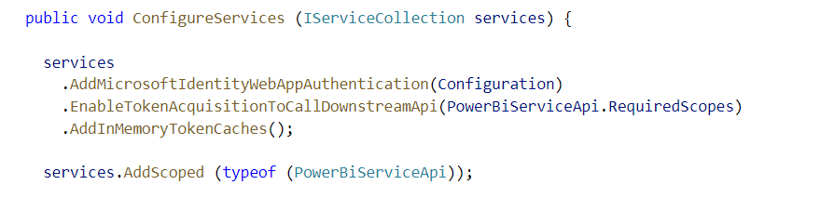
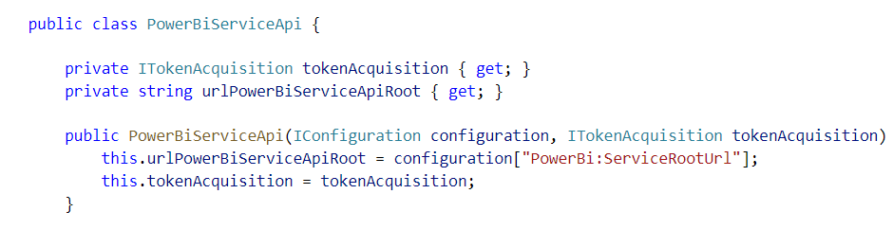
Adding Support for Token Acquisition
Modify ConfigureService in Startup.cs
Add a new C# Class named PowerBiServiceAPi
Dependency injection

Slide 30
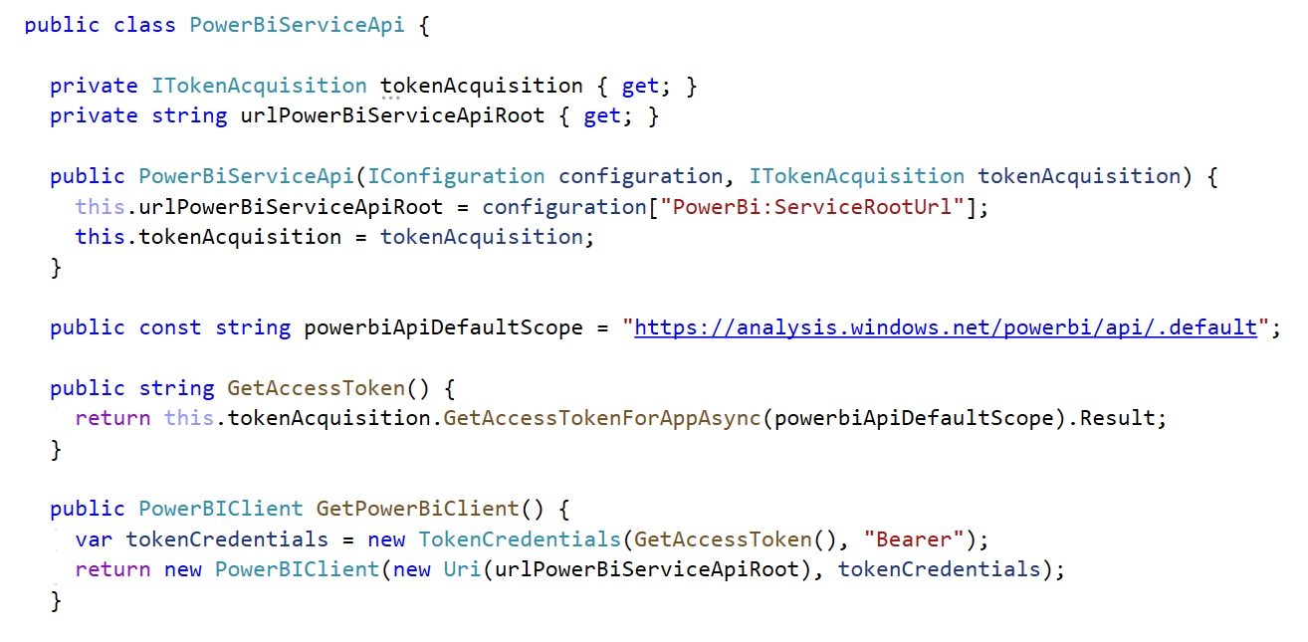
Authenticating with Azure AD as Service Principal

Slide 31
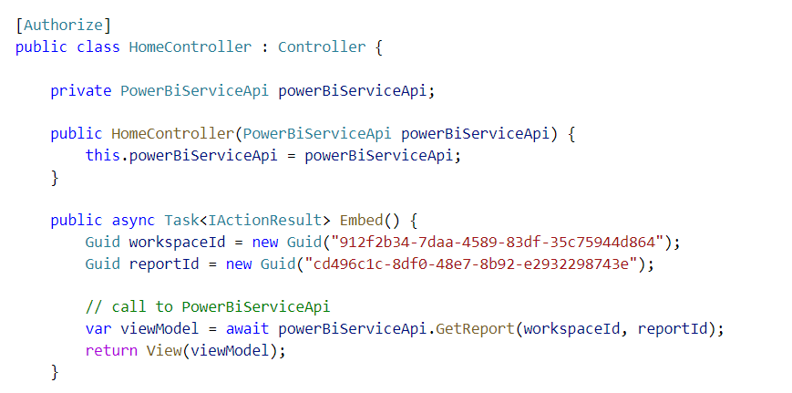
Accessing PowerBiServiceApi from a Controller
Dependency injection
MSAL Token Acquisition Service
PowerBiServiceAPI
HomeController
Dependency Injection
Dependency Injection

Slide 32
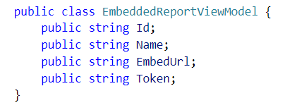
Call GetReportInGroupAsync to Get Embedding Data

Slide 33
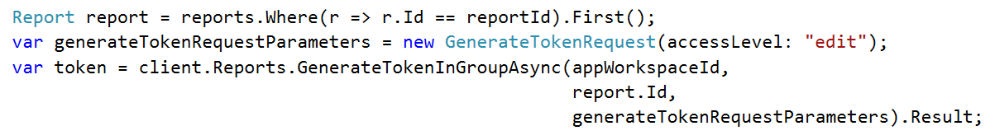
Generating Embed Tokens
App-Owns-Data embedding requires developer to generate embed tokens
Developer controls what permissions are extended to user for embedding purposes
Generating embed tokens requires dedicated capacity for any production scenarios
You generate embed tokens with the Power BI Service API
Embed Token V1 API used to create single resource embed tokens (see example below)
Embed Token V2 API used to create multi-resource embed tokens (see example in later slide)
Embed token provides restrictions on whether user can view, edit or create
Embed token can be generated to support row-level security (RLS)

Slide 34
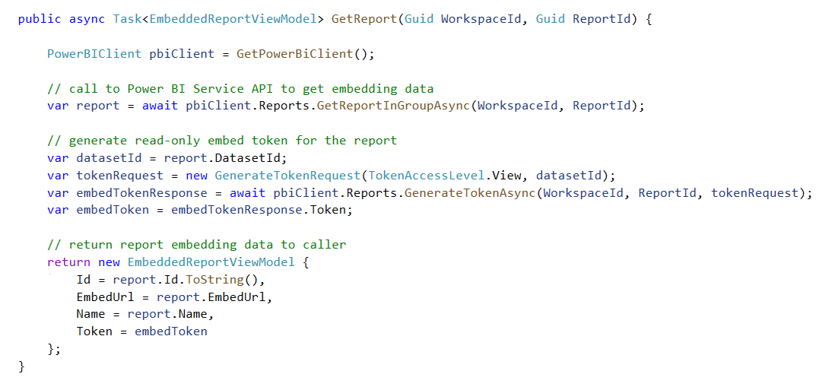
Getting the Data for Report Embedding

Slide 35
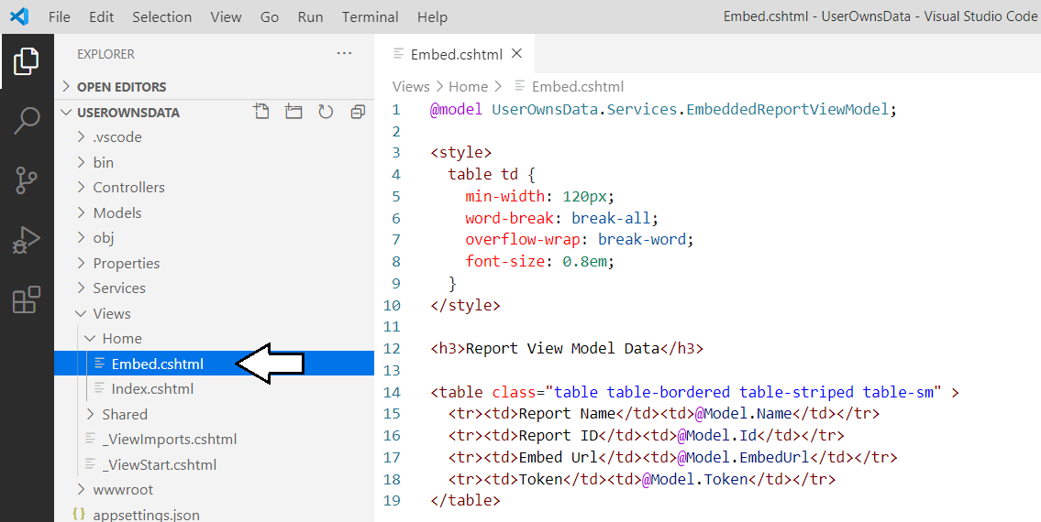
Displaying Data from the View Model

Slide 36
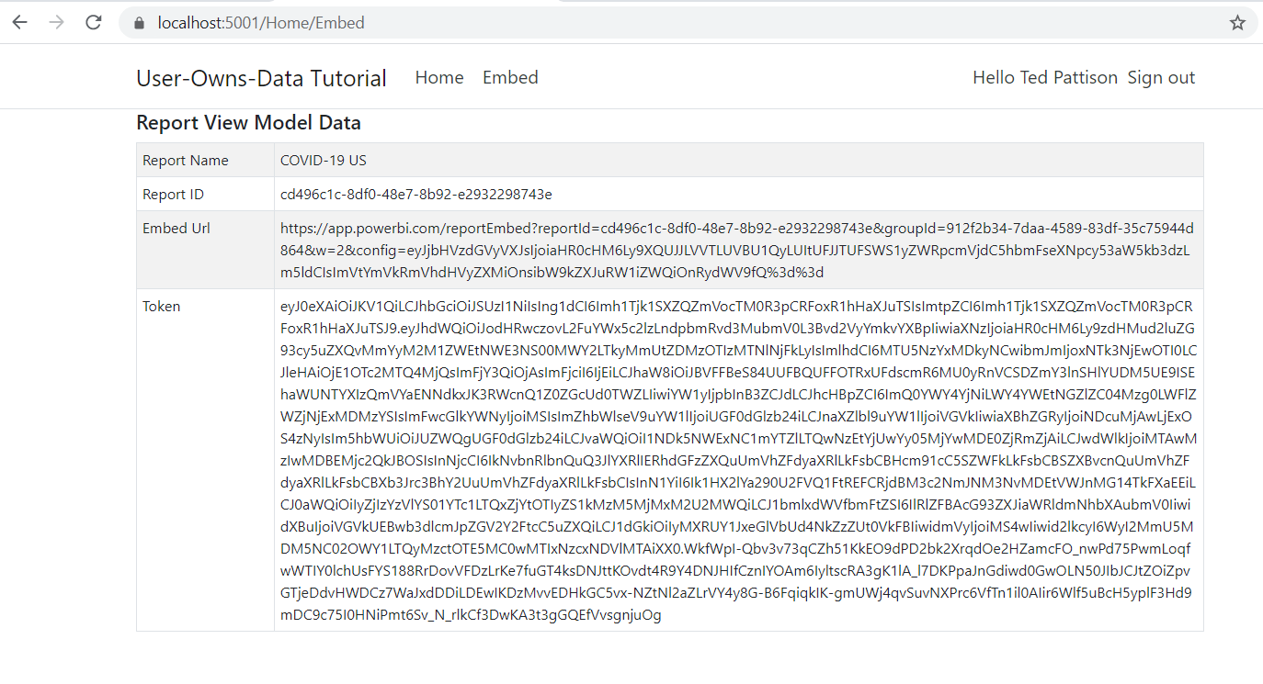
Exercise 3 Solution

Slide 37
Agenda
Developing for Power BI with .NET 5
Introducing Microsoft.Identity.Web
Calling to Power BI as Service Principal
Programming the Power BI JavaScript API
Adding TypeScript Support to a .NET 5 Project
Programming with Multi-Resource Embed Tokens
Integrating RLS using EffectiveIdentity

Slide 38
Exercise 4 Embedding a Report using powerbi.js
Add a script link to powerbi.js
Create view model to pass embedding data to browser
Write JavaScript code to embed a report

Slide 39
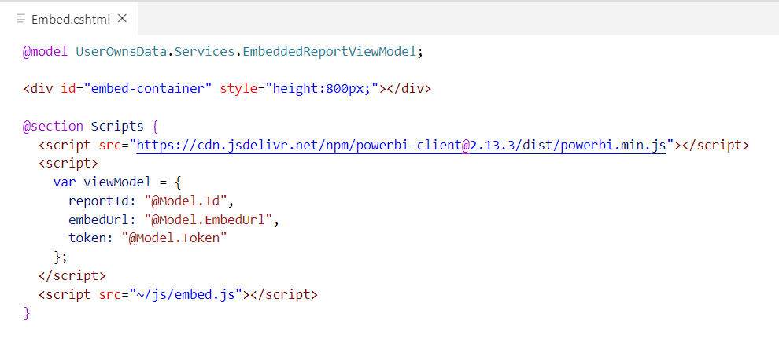
Creating a Simple View To Embed a Report
First script link loads Power BI JavaScript API
Second script link adds view model to web page with report embedding data
Third script link loads a custom Javascript file named embed.js that you will write

Slide 40
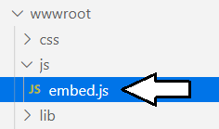
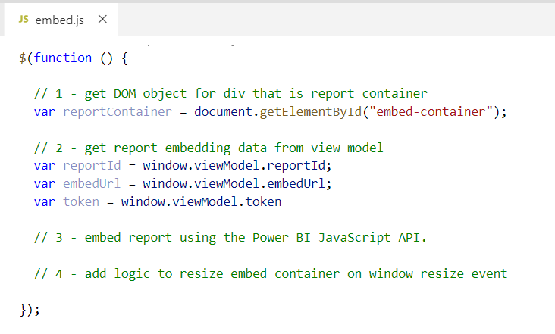
Retrieving Data from the Report View Model

Slide 41
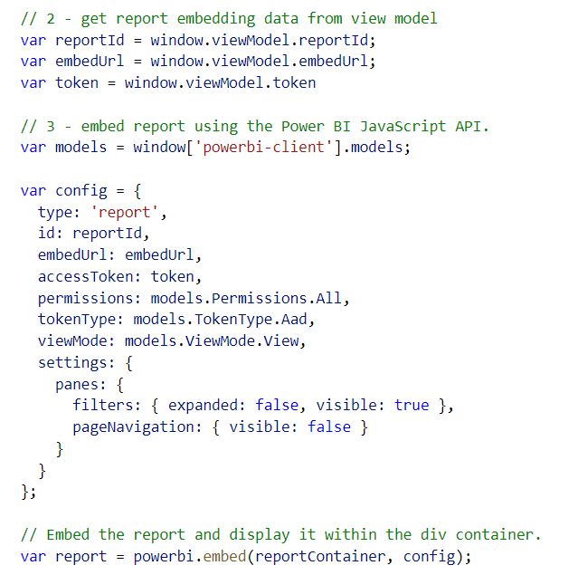
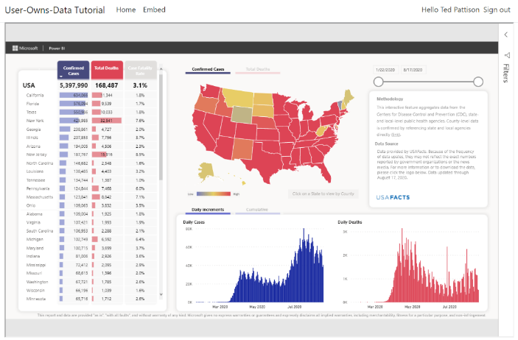
Embedding a Report using powerbi.js

Slide 42
Agenda
Developing for Power BI with .NET 5
Introducing Microsoft.Identity.Web
Calling to Power BI as Service Principal
Programming the Power BI JavaScript API
Adding TypeScript Support to a .NET 5 Project
Programming with Multi-Resource Embed Tokens
Integrating RLS using EffectiveIdentity

Slide 43
Exercise 5 Adding TypeScript/Webpack Support to a .NET 5 Project
Copy package.json file to UserOwnsData project root folder
Execute npm install to install Node.js packages
Copy tsconfig.json and webpack.config.js to root folder
Add new TypeScript file named embed.ts
Execute npm run build to compile embed.ts to embed.js
Update UserOwnsData.csproj with npm run build command

Slide 44
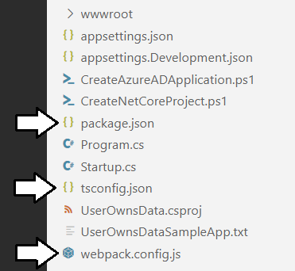
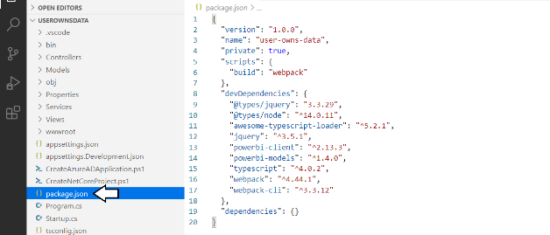
Adding Node.js Support for TypeScript Compilation

Slide 45


Running npm install

Slide 46

Understanding Webpack and Dynamic Module Loading
embed.ts
webpack
embed.js
jquery.js
Typescript Compiler
Powerbi.js

Slide 47


Running npm build

Slide 48

Updating UserOwnsData.csproj

Slide 49


Running dotnet build

Slide 50

Programming the PBI JS API using TypeScript

Slide 51


Exercise 6 Creating a View Model for App Workspaces

Slide 52

Creating the User Experience

Slide 53
Agenda
Developing for Power BI with .NET 5
Introducing Microsoft.Identity.Web
Calling to Power BI as Service Principal
Programming the Power BI JavaScript API
Adding TypeScript Support to a .NET 5 Project
Programming with Multi-Resource Embed Tokens
Integrating RLS using EffectiveIdentity

Slide 54

Programming with Multi-Resource Embed Tokens
Used in App-Owns-Data embedding

Slide 55
Agenda
Developing for Power BI with .NET 5
Introducing Microsoft.Identity.Web
Calling to Power BI as Service Principal
Programming the Power BI JavaScript API
Adding TypeScript Support to a .NET 5 Project
Programming with Multi-Resource Embed Tokens
Integrating RLS using EffectiveIdentity

Slide 56

What Is Row-level Security (RLS)?
Security Scheme for Power BI Datasets based on Named Roles
Roles are defined using Power BI Desktop or Tabular Object Model (TOM)
Each role is scoped to the dataset
Role defined using one or more DAX expressions
DAX expressions restrict which rows are accessible

Slide 57

Embedding RLS-enabled Reports
Programming with EffectiveIdentity
Trying to embed an RLS-enabled report without EffectiveIdentity will fail
EffectiveIdentity containing 1 or more roles must be added to embed token
Roles added into EffectiveIdentity as string array

Slide 58

Generating Embed Tokens with EffectiveIdentity

Slide 59

Sample Application with App-Owns-Data and RLS
https://github.com/PowerBiDevCamp/AppOwnsDataWithRLS

Slide 60
Summary
Developing for Power BI with .NET 5
Introducing Microsoft.Identity.Web
Calling to Power BI as Service Principal
Programming the Power BI JavaScript API
Adding TypeScript Support to a .NET 5 Project
Programming with Multi-Resource Embed Tokens
Integrating RLS using EffectiveIdentity

Slide 61
Questions

